Slide 1

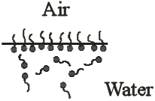

Lecture 4.
Surface phenomena. Adsorption at the gas – liquid interface.
Gibbs equation.
Ducleaux-Traube rule and Szyszkowski equation.
Surface activity. Surfactants.
(1)
Adilbekova A.O

Slide 2

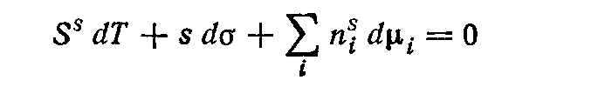
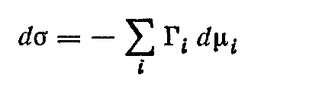
(1)
(2)
(3)
(3) - (1)
(4)
/s and T=const
(5)

Slide 3



For the binary system (an index 1-solvent, an index
2-the dissolved substance)
(6)
If Г₁ = 0, we can write:
(7)
(8)

Slide 4



Or we can write:
where a₂ is the activity of component 2. It follows that:
(9)
(10)
For the dilute solution we can use next equation:
(11)

Slide 5
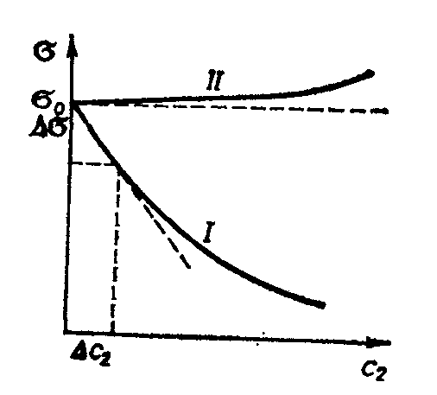

Figure 1. Dependence of a surface tension on concentration of surface-active (I) and inactive (II) substances
Surface indifferent subsatances (sugar solution).
(I)
(II)
amphipiphilic substances show strong surface
activity with respect to water

Slide 6


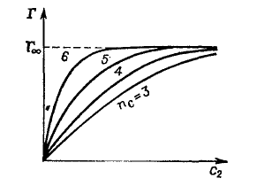
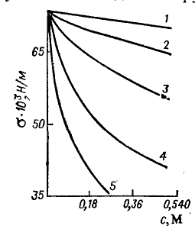
Surface activity g
The experimental studies carried out by Ducleaux and Traube (1884 - 1886) showed that within the same homologous series the extension of a surfactant chain length by each CH2 group causes an increase in dσ/dc by a factor of 3 to 3.5

Slide 7
B – constant, K changes in homologous series
Szyszkowski equation

Slide 8
Questions?
Thank you for your attention!
Adilbekova A.O

